Slide 1
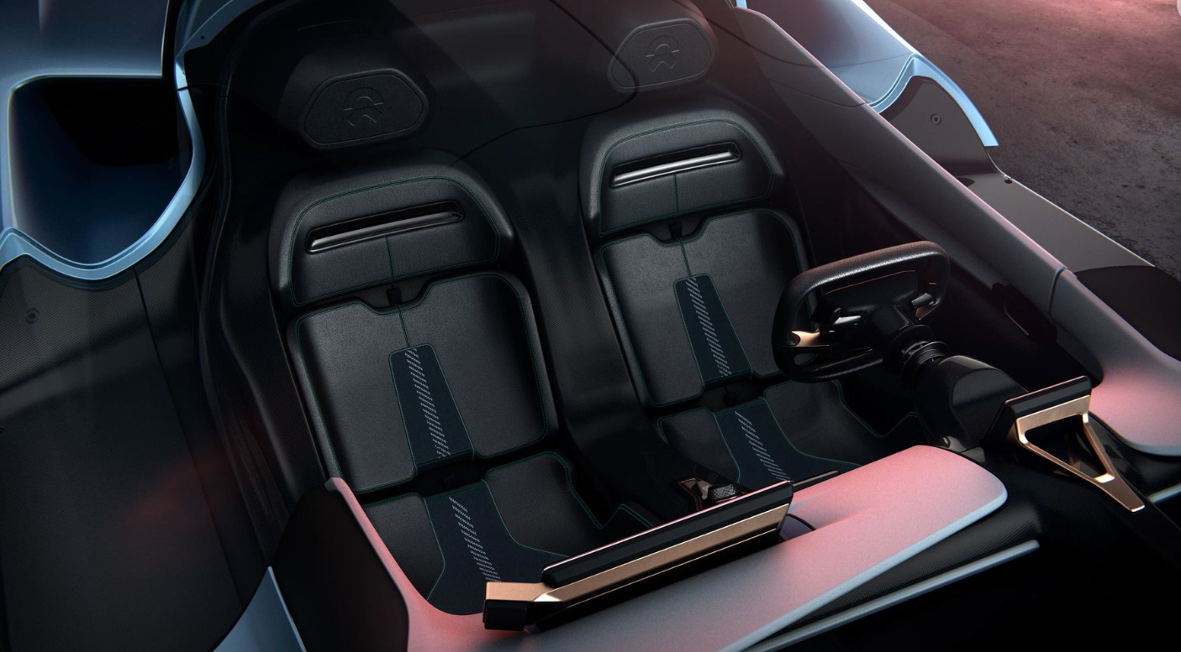
Plug-in Electric Vehicle Sales using SAC

Slide 2






Group 4
Johanna Albarracin. Nora Collins. Rick Gonzalez. Julie Gutierrez. Ferez Khavarian. Luis Martinez. Jamie Westby.

Slide 3
DATA SOURCES
Alternative fuels data center, Tesla Company, International Energy Agency
DATA SIZE
Total data size 32 MB
Notes:
Creation on file in SAP that was shared in a file called Group 4 with all the group members
https://www-statista-com.mimas.calstatela.edu/search/?q=EV+purchase+likelihood+in+the+U.S+by+consumer+age+group+2021&Search=&qKat=search&newSearch=true
Number of Tesla locations in the USA in 2023 | ScrapeHero
Data Source: afdc.energy.gov ( Alternative fuels data center)
https://www-statista-com.mimas.calstatela.edu/statistics/1305918/us-transportation-co2-emissions-projections-by-fuel-type/?locale=en
https://www.iea.org/data-and-statistics/charts/number-of-available-electric-car-models-by-type-and-region-2021

Slide 4
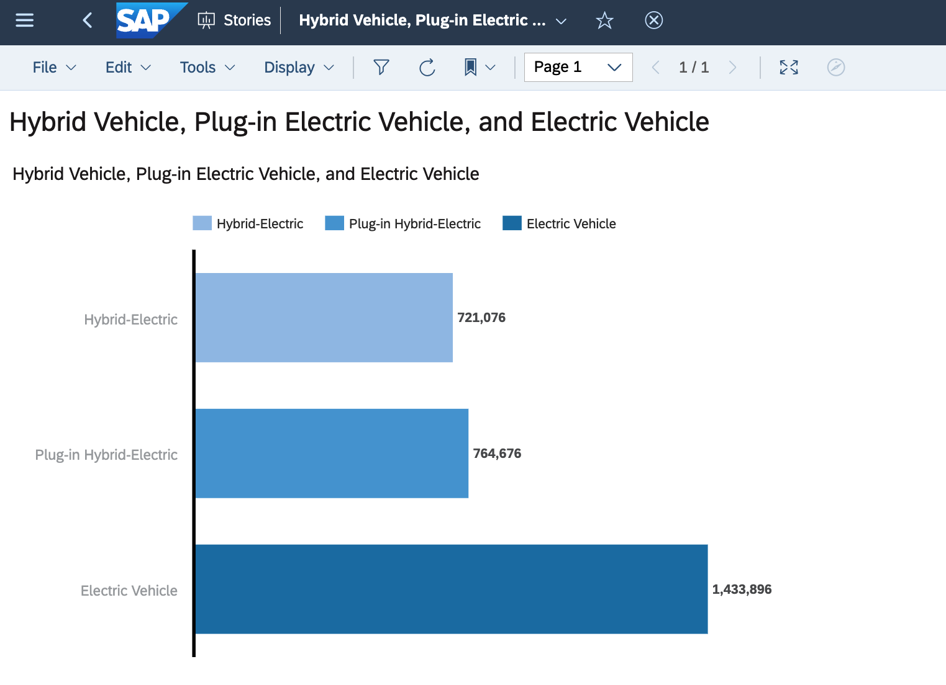
Electric vehicles are taking the U.S market industry by storm
Notes:
Along this presentation we will look at different data that shows how the electric vehicles are taking the U.S by storm, in the graph there are three different way an electric car is powered hybrid electric, plug in hybrid electric, where the electric has the biggest percentage in the U.S market
Compared to plug-in hybrids, electric vehicles have several advantages. Some buyers are drawn to electric vehicles because they are better for the environment than plug-in hybrids. EVs do not use any gasoline.

Slide 5
Tesla Model Units Sold Per
Midsize Luxury Vehicles
Tesla has highest new vehicle registration for 2022.
Tesla is considered the sole market leader in the midsize luxury market with 195,698 registrations (up 59% in one year).
Lexus ES is behind Tesla Model 3 with 41,465, followed by BMV 5 Series with 20,857.
Lexus GS and Jaguar were the lowest with 2 and 809 respectively.
Notes:
One of the highest electric vehicles is Tesla

Slide 6
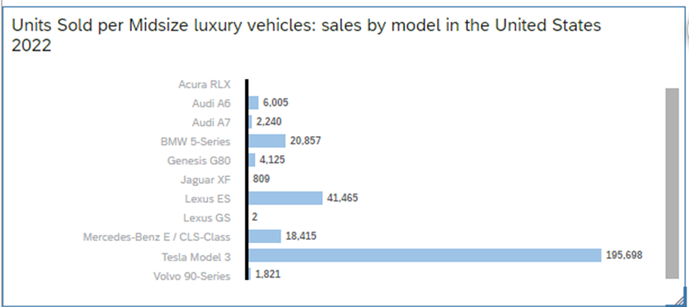
Tesla Model Units Sold Per
Midsize Luxury Vehicles
Notes:
As you can see in this graph Tesla of the models with most sales in 2022 in the unites states, followed by Lexus ES

Slide 7
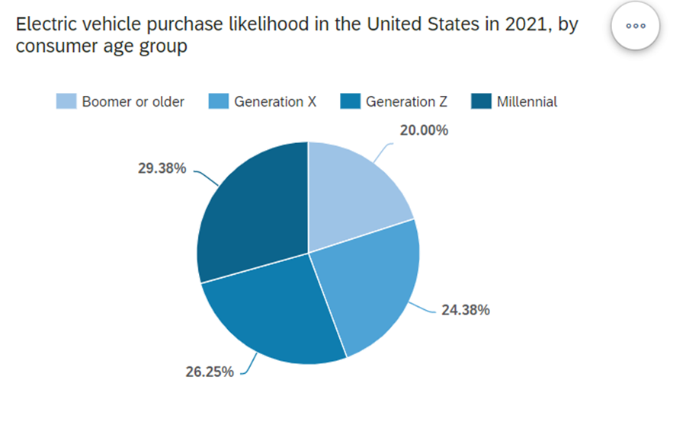
EV purchase by consumer age group
Millennial drivers are at the forefront of the electric car trend ​
There are several reasons why millennials are choosing to drive electric vehicles. ​
Electric cars are much more environmentally friendly than gasoline powered cars. ​
Electric cars often have an overall lower cost of ownership than petroleum fueled cars. ​
Gen Z's primary interest is because EV’s are viewed as "cool and hip" to drive. ​
Baby Boomers are the least likely to show an interest in buying an Electric Vehicle.​
Notes:
According to the research represented in this pie chart graph, millennial drivers are the forefront of the electric card trend

Slide 8
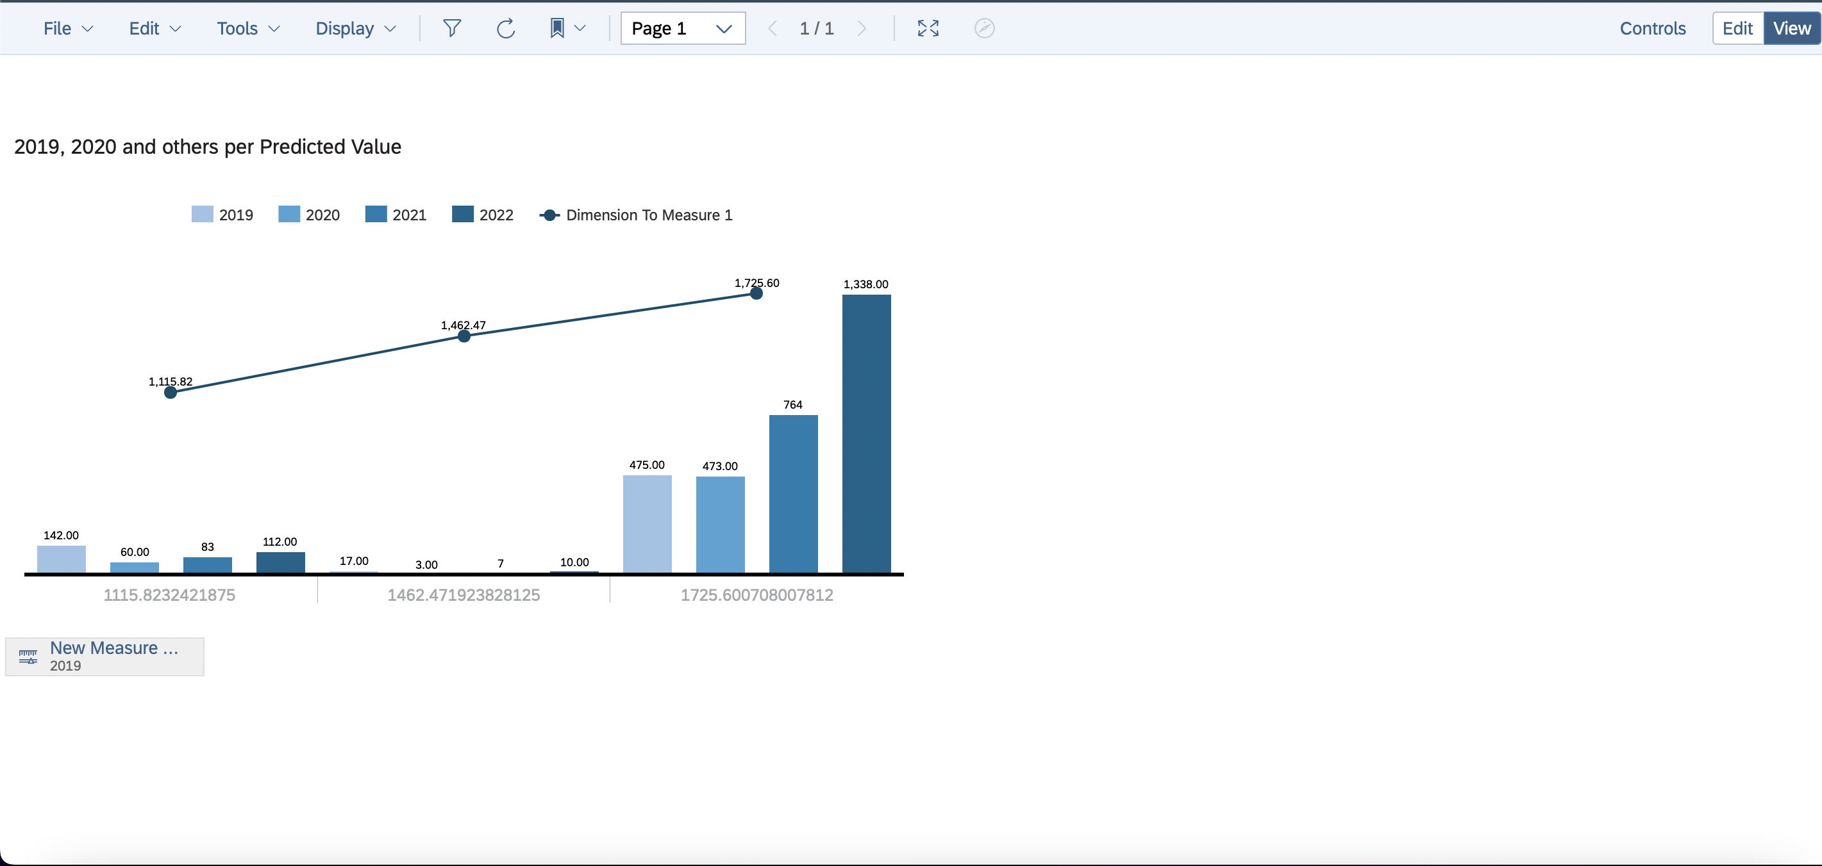
Fuel Technology type with the most incentives
Notes:
According to the law and incentive additions in the United States electric vehicles are the car with the more incentives in the US.

Slide 9
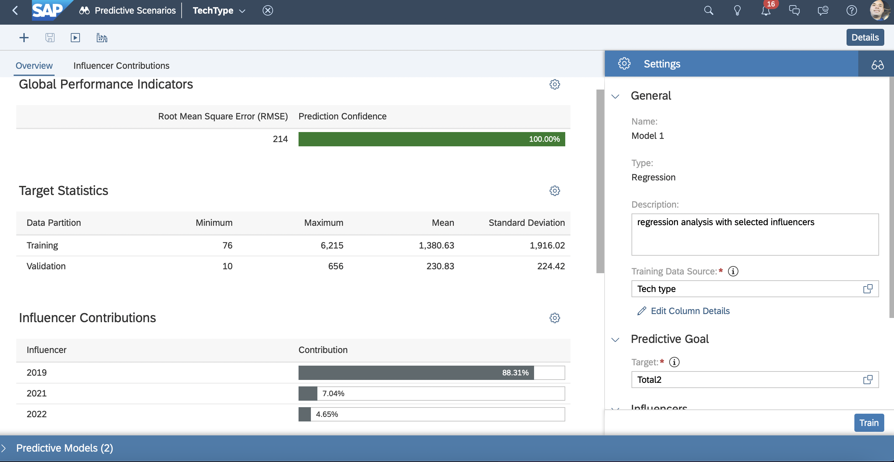
Fuel Technology type with the most incentives
Notes:
The variable to create the model was the year

Slide 10
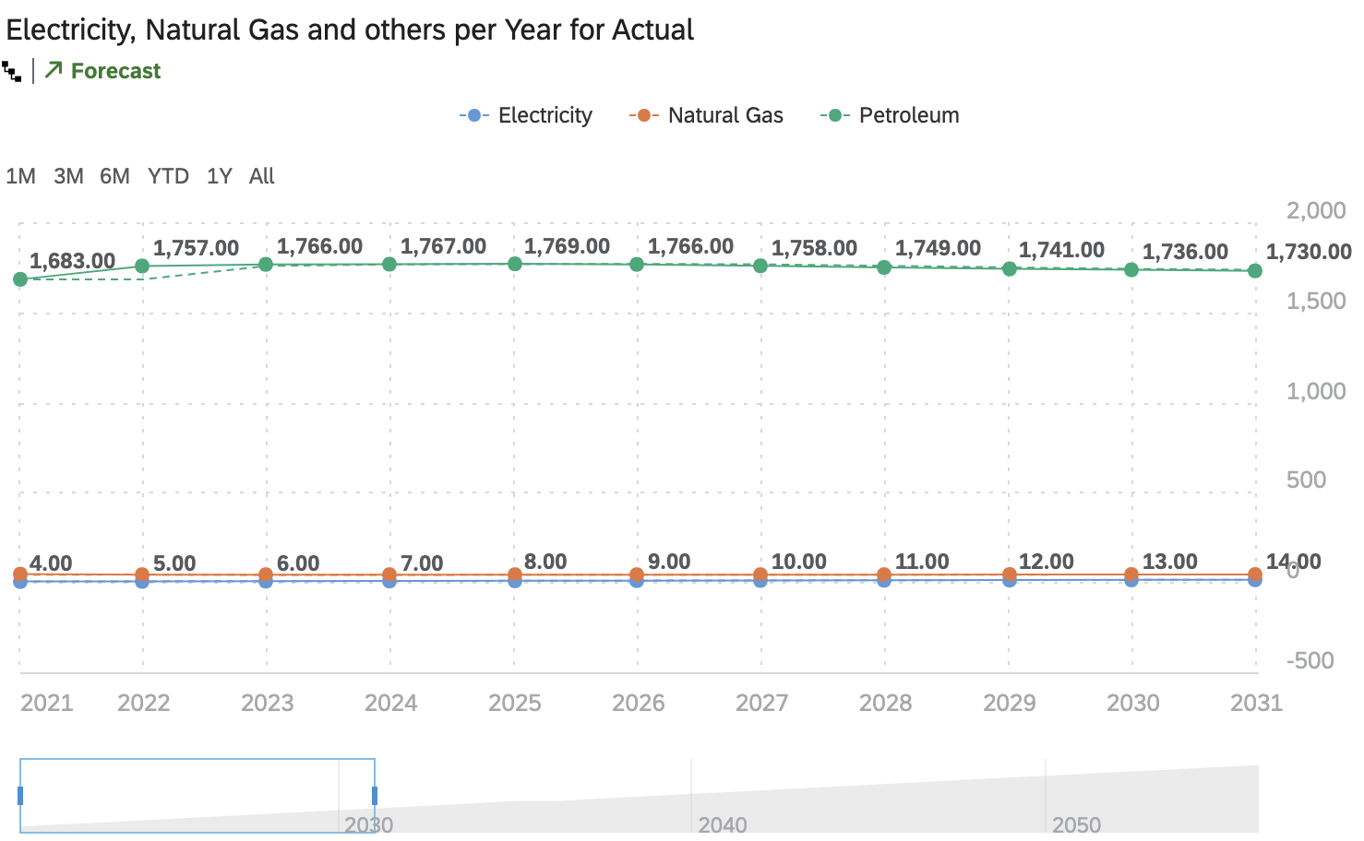
Impact on Environment
Predicted CO2 emissions in the United States by fuel type (in million metric tons)
Notes:
The graph below shows the time series analysis and forecast of CO2 emissions (in million metric tons) predictions in the United States from 2021 to 2031. Electricity, Natural Gas, and Petroleum are represented. The graph shows a gradual increase in total fuel type emissions. Petroleum has the highest levels of CO2 released into the atmosphere and Electricity contributes the least amount. As the transition to electric vehicles is encouraged through various incentives and associated benefits, it is predicted that Petroleum emissions will eventually decrease. Based on the data, purchasing a Tesla Model 3 will contribute greatly to the reduction of CO2 emissions overtime. According to Tesla, current energy trends remain stable. The emissions generated from electric vehicles are expected to decline over time with the addition of greener energy resources.

Slide 11
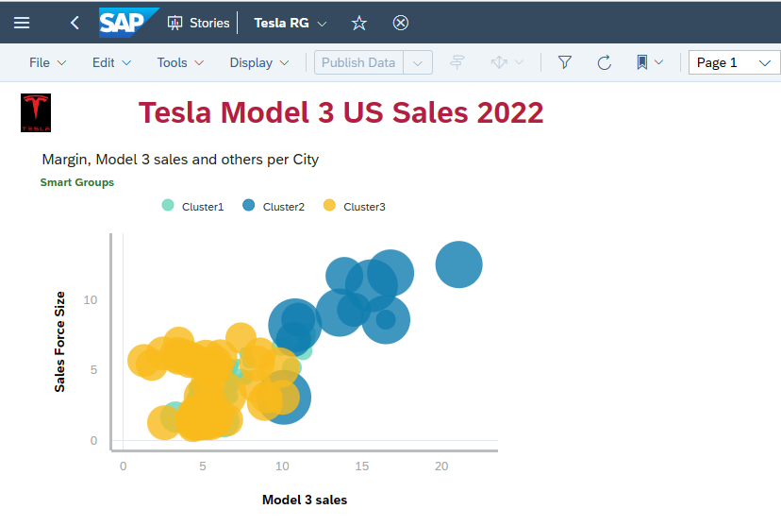
Increased Demand for Hybrid Cars
Notes:
Cluster 1,2 & 3 represent increased sales of Tesla Model 3 in the last quarter of 2022 and beginning of 2023, by city, state and dealership in the country.
Final numbers have not been reported yet........as we are still in the first Quarter of 2023.
Clusters are scattered according to state, city, and Official Tesla dealership in the US.

Slide 12
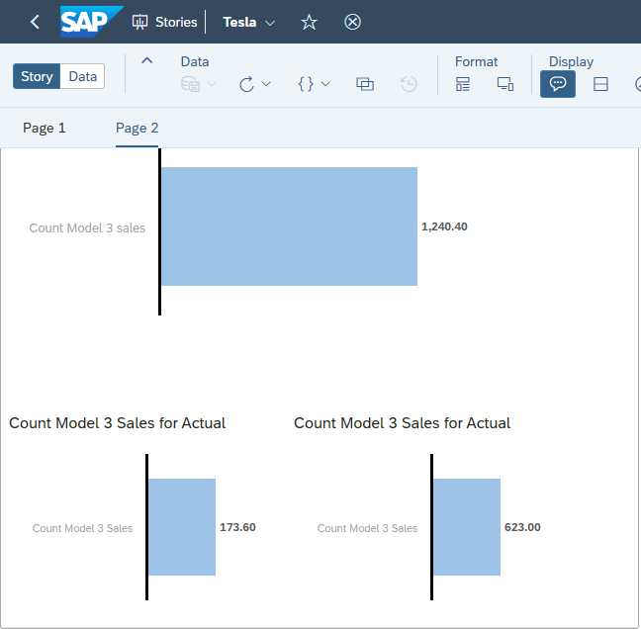
Increased Demand for Hybrid Cars
Notes:
These graphs represent highest number of sales of Tesla Model 3 in the major cities of the US, according to the scattered clusters #1, #2 & #3 in the previous slide. We can conclude that the Tesla Model 3 is the Iconic vehicle which accounts for a significant percentage of Tesla profitablbility.

Slide 13
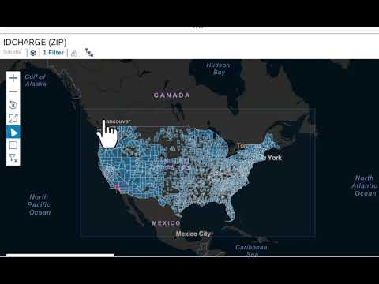
EV Charging stations in the US
Notes:
According to the geo map..... the state of California is the one with the most charging stations........ the region with the most charging stations is Los Angeles followed by San Francisco and San Diego.

Slide 14
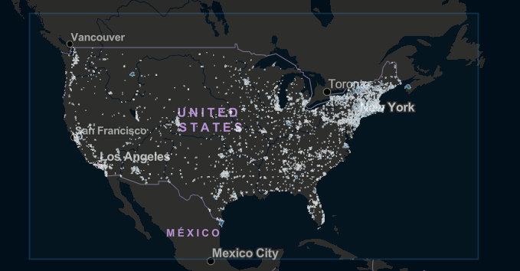
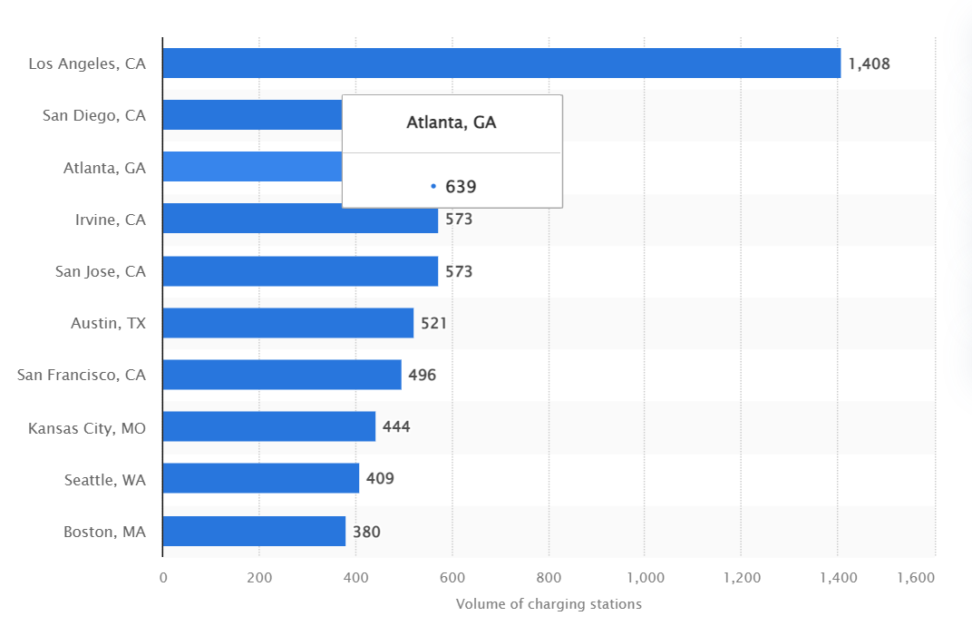
Cities with the most charging stations in the US
Notes:
We also can see with a different view the accumulation on stations on the east coast. And none in the mid west.

